Slide 1
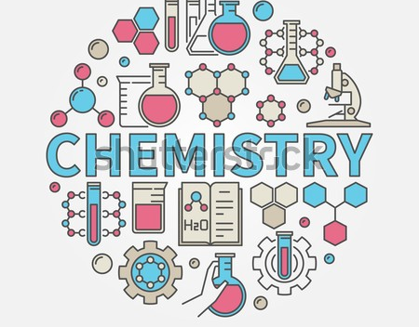
Different Chemistry Topics
S.M.Maksudur Rahamn Shanto IS-12-40
January 23, 2025

Slide 2

1st Topic
Variation Of Ionization Potential And Electron Affinity Within Periods And Groups In The Elements In The Periodic Table

Slide 3
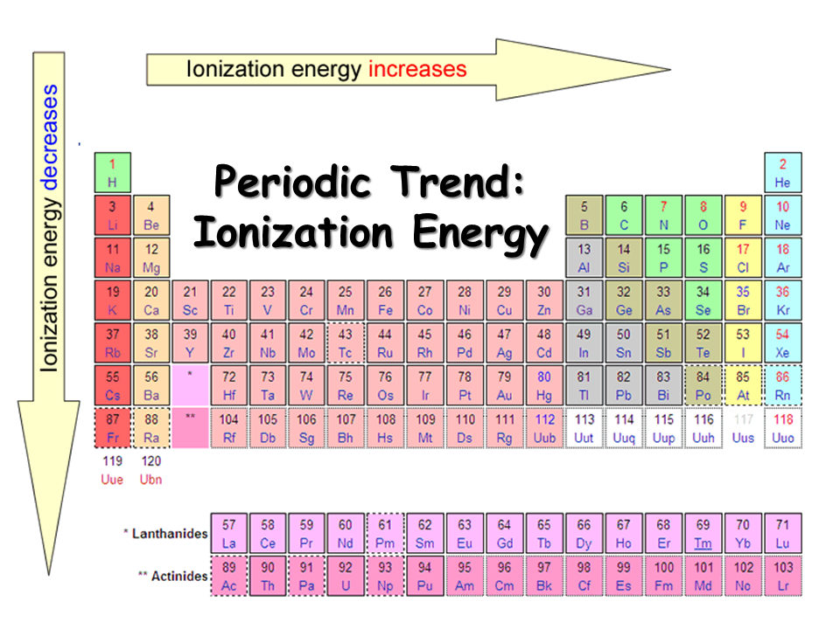
Variation of Ionization Potential Within Periods
Ionization potential refers to the energy required to remove an electron from an atom or ion in its gaseous state.
Within a period, the ionization potential generally increases from left to right.
This trend can be attributed to the increasing effective nuclear charge, which attracts the electrons more strongly and requires more energy for removal.

Slide 4
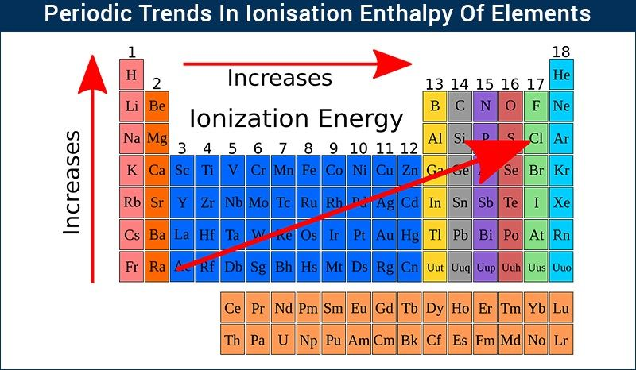
Variation of Ionization Potential Within Groups
Within a group, the ionization potential generally decreases from top to bottom.
This trend can be explained by the increasing atomic size and shielding effect.
As atoms get larger and have more electron shells, the outermost electrons experience less attraction from the nucleus, making them easier to remove.

Slide 5
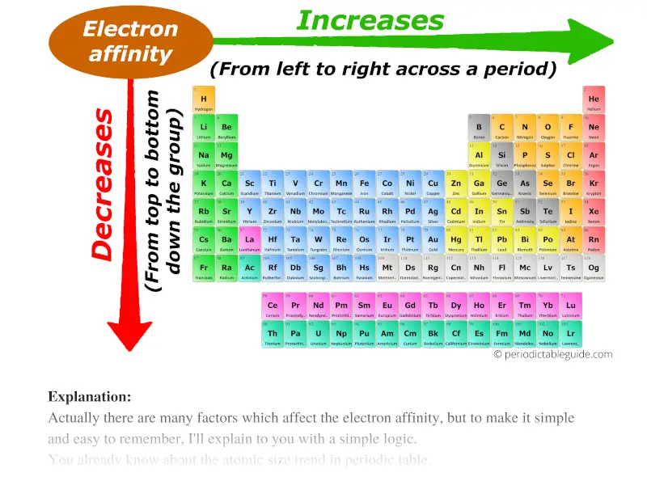
Variation of Electron Affinity Within Periods
Electron affinity refers to the energy change that occurs when an electron is added to an atom or ion in its gaseous state.
Within a period, the electron affinity generally increases from left to right.
This trend is mainly due to the increasing effective nuclear charge, which attracts the added electron more strongly and releases more energy.

Slide 6
Variation of Electron Affinity Within Groups
Within a group, the electron affinity generally decreases from top to bottom.
This trend can be explained by the increasing atomic size and shielding effect.
As atoms get larger and have more electron shells, the added electron experiences less attraction from the nucleus, resulting in a lower energy change.

Slide 7

2nd Topic
Chemical Bonding : A Brief Discussion On Ionic, Covalent And Coordinate Bond.

Slide 8
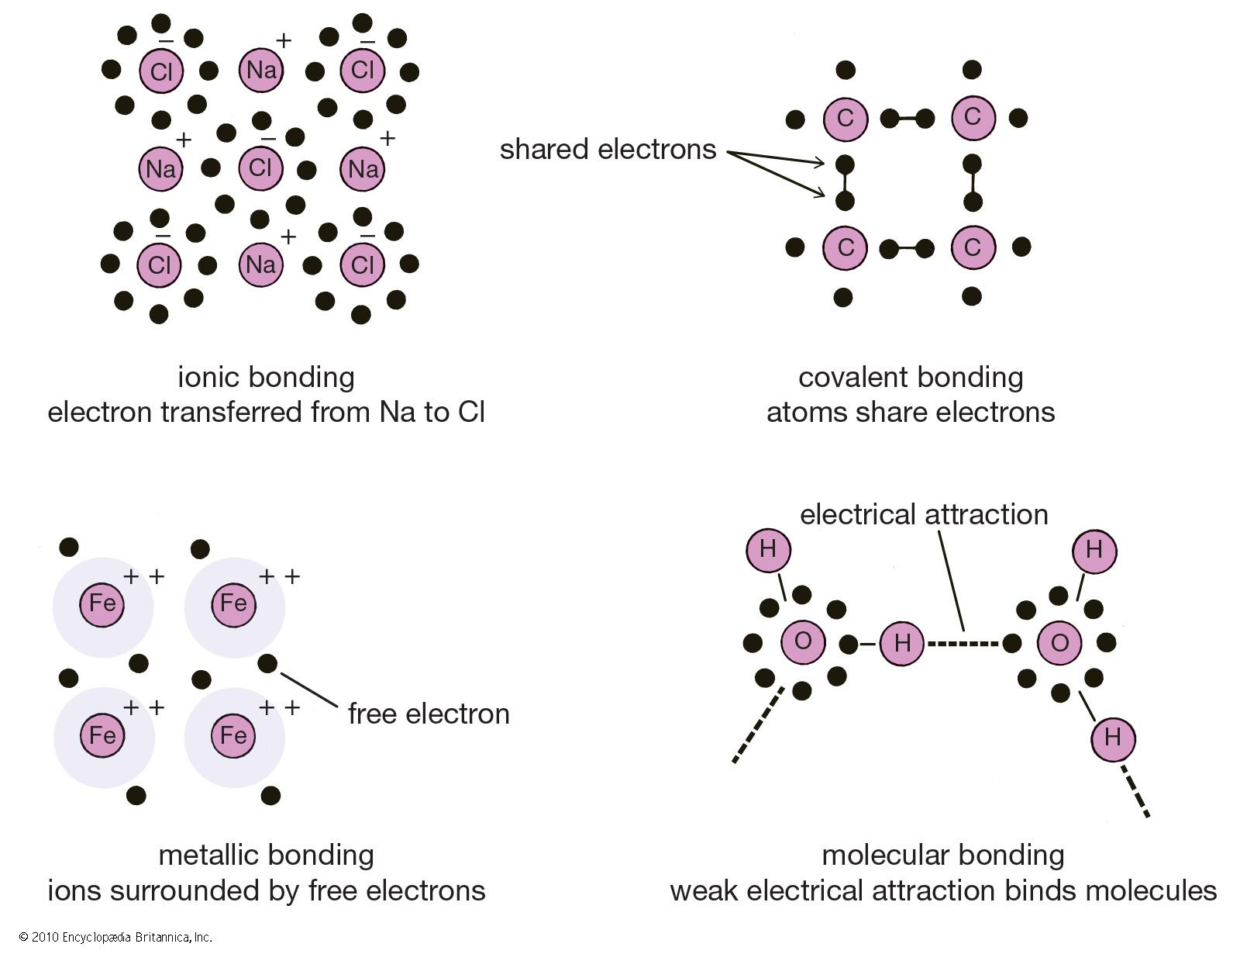
Introduction to Chemical Bonding
Chemical bonding refers to the attraction between atoms that holds them together and forms compounds.
There are three main types of chemical bonds: ionic, covalent, and coordinate bonds.
Understanding these bonds helps us understand the properties and behavior of different substances.

Slide 9
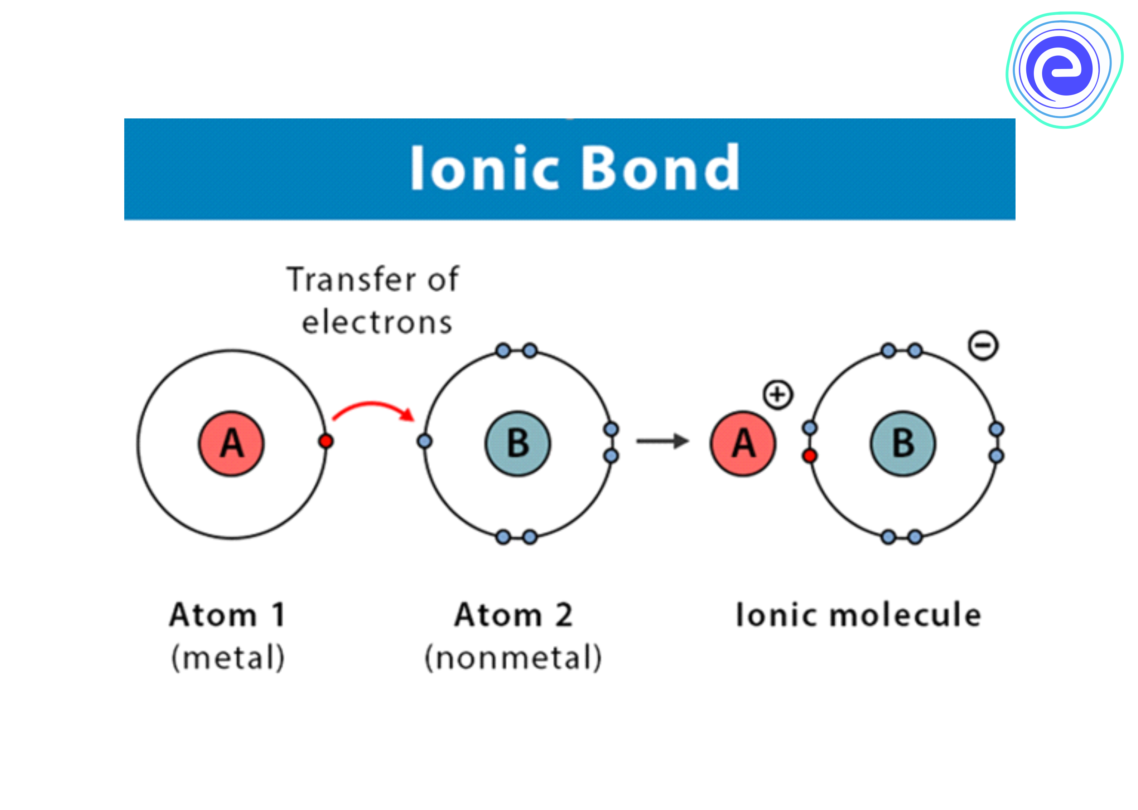
Ionic Bonding
Ionic bonding occurs between a metal and a non-metal.
In an ionic bond, electrons are transferred from the metal atom to the non-metal atom, creating positive and negative ions.
The resulting electrostatic attraction between the oppositely charged ions forms a strong bond.

Slide 10
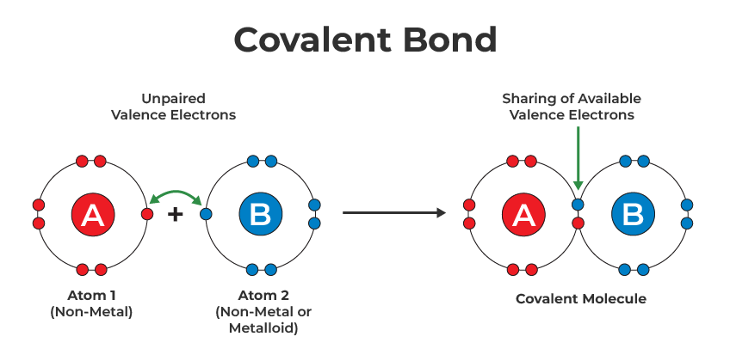
Covalent Bonding
Covalent bonding occurs between non-metal atoms.
In a covalent bond, atoms share electrons to achieve a stable electron configuration.
The shared electrons form a bond that holds the atoms together.

Slide 11
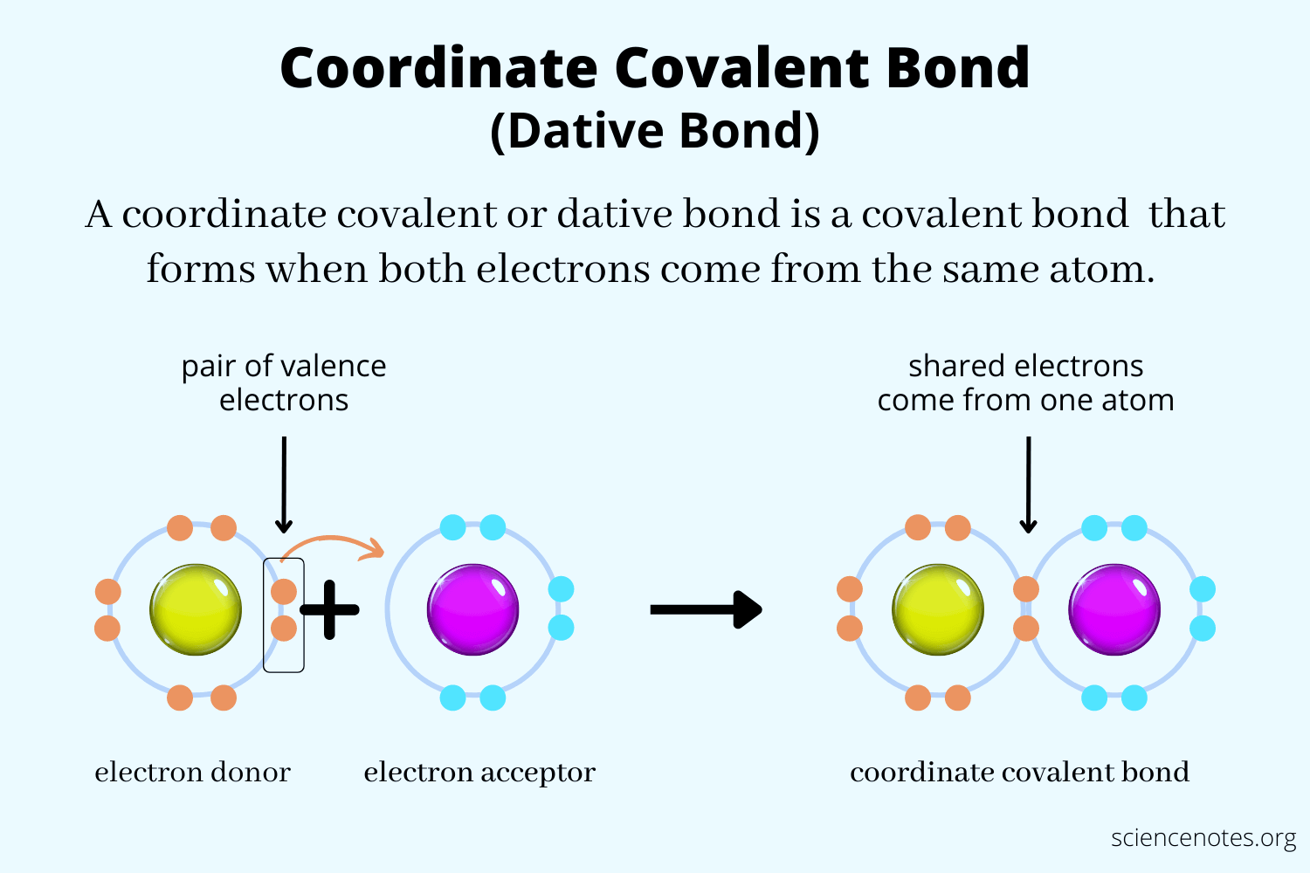
Coordinate Bonding
Coordinate bonding, also known as dative bonding, occurs when one atom donates a pair of electrons to another atom.
The atom donating the electron pair is called the donor, while the atom accepting the electrons is called the acceptor.
The shared electron pair forms a coordinate bond, which is a type of covalent bond.

Slide 12
3rd Topic
Comparative Analysis Of Alcohol And Phenol Properties, Reaction And Application

Slide 13
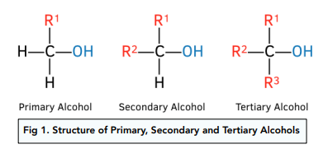
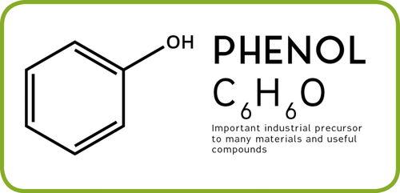
Introduction
- Alcohols have an -OH group attached to a saturated carbon atom. Phenols have an -OH group attached to an aromatic ring.
Alcohols can be classified as primary, secondary, or tertiary based on the number of carbon atoms bonded to the carbon bearing the -OH group.
Alcohols have a higher boiling point compared to phenols due to the absence of hydrogen bonding between alcohol molecules.
Phenols have higher acidity compared to alcohols due to the stability of phenoxide ion

Slide 14
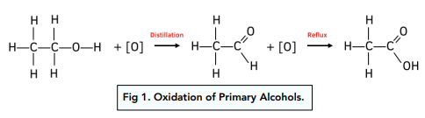
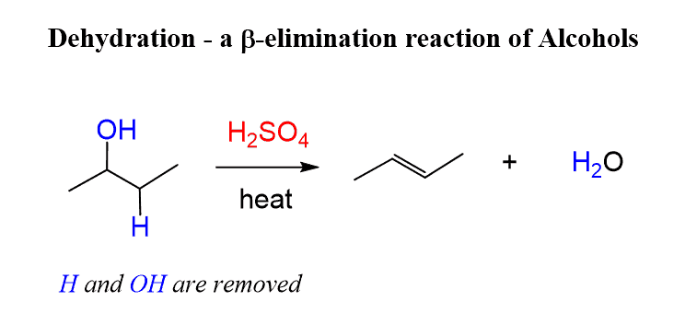
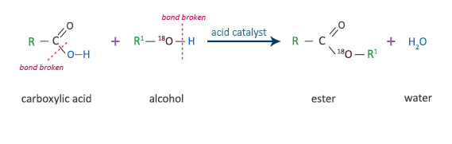
Reaction of Alcohols
Alcohols can undergo oxidation reactions to form aldehydes, ketones, or carboxylic acids, depending on the oxidizing agent used.
They can react with acids to form esters.
Alcohols can also undergo dehydration reactions to form alkenes under the presence of an acid catalyst.

Slide 15
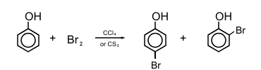
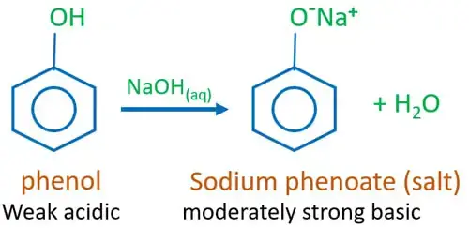
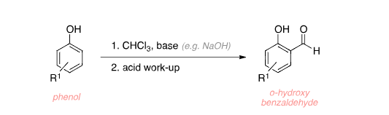
Reaction of Phenols
Phenol undergoes electrophilic aromatic substitution reactions readily and at a much faster rate than benzene, its parent hydrocarbon. This enhanced reactivity is due to the presence of the hydroxyl (-OH) group attached to the aromatic ring.
Phenols are weakly acidic. So they react with bases like NaOH to form salts.
A phenol (ArOH) reacts with chloroform (CHCl3) and a strong base (NaOH) to form an ortho-hydroxybenzaldehyde (ArCHO-OH). Its called Reimer-Tiemann reaction.

Slide 16
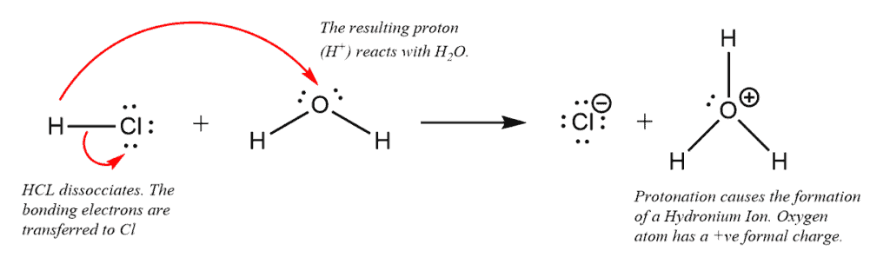
4th Topic
MECHANISM AND STEREOCHEMISTRY FOR THE SN2 REACTION

Slide 17
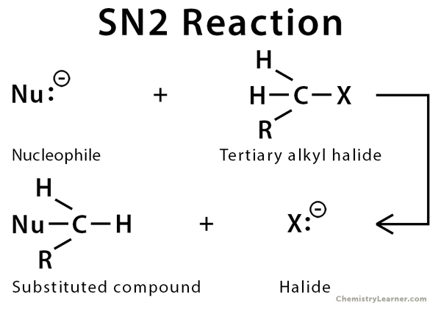
SN2 Reaction
The SN2 reaction is a type of nucleophilic substitution which an electron rich nucleophile displaces the halogen reaction is the type of nucleophilic substitution in atom bonded the central carbon of the alkyl halide molecules . The halide ion that is displaced from the carbon atom is called the leaving group . SN2 reaction take place at site of a saturated carbon atom .
Rate of Reactivity : 1˃ 2˃ 3

Slide 18
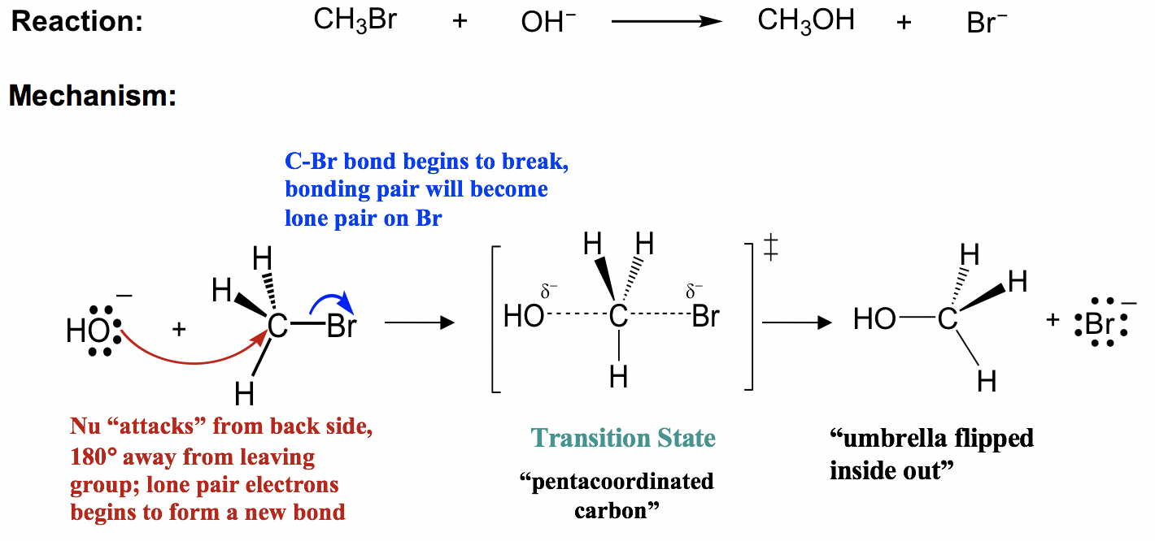
Mechanism of SN2 Reaction

Slide 19
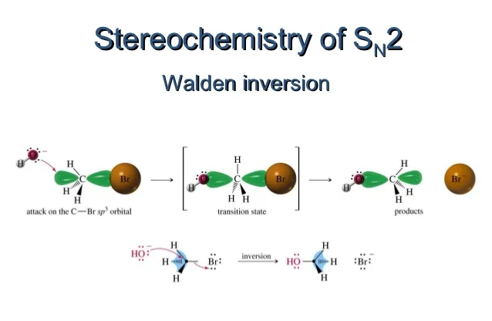
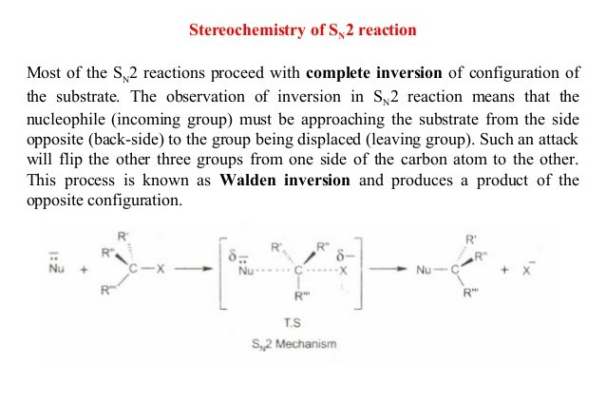
STEREOCHEMISTRY OF SN2 REACTION

Slide 20
Uses and application of SN2 REACTION
1.An important industrial process that employs SN2 reaction mechanism is the methylation of phenol to anisole. This reaction is catalyzed by dimethyl sulfate, and due to the SN2 reaction mechanism, it runs smoothly under mild condition.
2 .This process entails an intermediate reaction where acid chloride (ethanoic anhydride) is treated with an amine (p-aminophenol). Here, the nitrogen in the amine, acting as a potent nucleophile, reacts with the carbonyl carbon in the acid chloride, displacing the chloride as per SN2 mechanism.
Ethanoic anhydride + p-aminophenol -----> Paracetamol + Ethanol
3 .Formation of Glycerol :
Triglyceride + Alkali -----> Glycerol + Soap

Slide 21
Thank You
Alhamdulillah for Everything

